Slide 1
UNIT – V
Pipeline and Vector Processing
Parallel Processing
Pipelining
  Arithmetic Pipeline
  Instruction pipeline
  RISC pipeline
Vector Processing
Array Processors

Slide 2
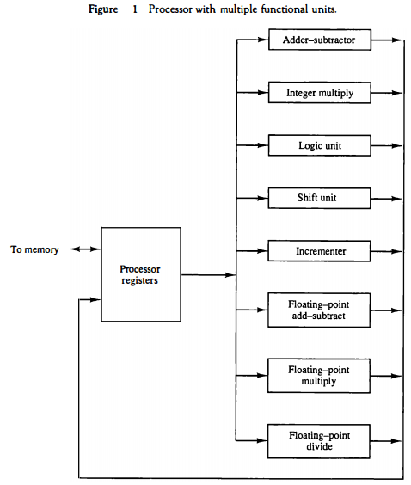
PARALLEL PROCESSING
A parallel processing system is able to perform concurrent data processing to achieve faster execution time.
The system may have two or more ALUs and be able to execute two or more instructions at the same time.
Goal is to increase the throughput – the amount of processing that can be accomplished during a given interval of time.
Parallel processing is established by distributing data among multiple functional units.
    Separate the execution unit into eight functional units operating in parallel.
    Operands in registers are given to one of units depending on the operation specified by instruction.

Slide 3
PARALLEL COMPUTERS
  There are variety of ways parallel processing can be classified.
  Flynn's classification
  Parallel processing may occur in instruction stream/data stream or both.
  - Instruction Stream
  Sequence of Instructions read from memory
  - Data Stream
  Operations performed on the data in the processor
Flynn’s classification divides computer into four major groups as follows:
Number of Data Streams
Single
Multiple
Number of
Instruction
Streams
Single
SISD
SIMD
Multiple
MISD
MIMD

Slide 4
SISD COMPUTER SYSTEMS
Control
Unit
Control signals
Processor
Unit
Data stream
Memory
Instruction stream
Single instruction stream, single data stream (SISD)
  Represents the organization of a single computer containing a control unit, a processor unit, and a memory unit.
  Instructions are executed sequentially and the system may or may not have internal parallel processing capabilities.
  Parallel processing may be achieved by means of multiple functional units or by pipeline processing.

Slide 5
SIMD COMPUTER SYSTEMS
Memory
Data bus
Control Unit
Instruction stream
P
P
• • •
P
Processor units
Data stream
Alignment network
M
M
• • •
M
Memory modules
Single instruction stream, multiple data stream (SIMD)
includes many processing units under the supervision of a common control unit.
  All processors receive the same instruction from the control unit but operate on different items of data.
  The shared memory unit must contain multiple modules so that it can communicate with all the processors simultaneously.

Slide 6
MISD COMPUTER SYSTEMS
M
CU
P
M
CU
P
Memory
•
•
•
•
•
•
M
CU
P
Data stream
Instruction stream
MISD structure is only of theoretical interest since no practical system has been constructed using this organization.

Slide 7
MIMD COMPUTER SYSTEMS
P
M
P
M
• • •
P
M
Interconnection Network
Shared Memory
MIMD organization refers to a computer system capable of processing several programs at the same time. It has multiple processing units that executes multiple instructions on multiple data.
e.g. multiprocessor and multicomputer system.

Slide 8
Parallel processing is considered under
Pipeline processing – arithmetic suboperations or the phases of computer instruction cycle overlap in execution.
Vector processing – deals with computations involving large vectors and matrices
Array processors – performs computations on large arrays of data.

Slide 9
PIPELINING
  A technique of decomposing a sequential process into suboperations, with each subprocess being executed in a partial dedicated segment that operates concurrently with all other segments (operates in overlapped manner).
Multiply and add operation : A_{i} * B_{i} + C_{i} for i = 1, 2, 3, ... , 7
A_{i}
B_{i}
Memory
C_{i}
Segment 1
R1
R2
Multiplier
Segment 2
R3
R4
Segment 3
Adder
R5
R1 ← A_{i}, R2 ← B_{i} Load A_{i} and B_{i}
R3 ← R1 * R2, R4 ← C_{i} Multiply and load C_{i}
R5 ← R3 + R4 Add
3 Suboperation Segment

Slide 10
OPERATIONS IN EACH PIPELINE STAGE
Multiply and add operation : A_{i} * B_{i} + C_{i} for i = 1, 2, 3, ... , 7
A_{i}
B_{i}
Memory
C_{i}
Clock
Pulse
Segment 1
Segment 1
Segment 2
Segment 3
R1
R2
  Number R1 R2 R3 R4 R5
  1 A1 B1
  2 A2 B2 A1 * B1 C1
  3 A3 B3 A2 * B2 C2 A1 * B1 + C1
  4 A4 B4 A3 * B3 C3 A2 * B2 + C2
  5 A5 B5 A4 * B4 C4 A3 * B3 + C3
  6 A6 B6 A5 * B5 C5 A4 * B4 + C4
  7 A7 B7 A6 * B6 C6 A5 * B5 + C5
  8 A7 * B7 C7 A6 * B6 + C6
  9 A7 * B7 + C7
Multiplier
Segment 2
R3
R4
Segment 3
Adder
R5
3 Suboperation Segment
R1 ← A_{i}, R2 ← B_{i} Load A_{i} and B_{i}
R3 ← R1 * R2, R4 ← C_{i} Multiply and load C_{i}
R5 ← R3 + R4 Add

Slide 11
OPERATIONS IN EACH PIPELINE STAGE
Clock
Pulse
Segment 1
Segment 2
Segment 3
  Number R1 R2 R3 R4 R5
  1 A1 B1
  2 A2 B2 A1 * B1 C1
  3 A3 B3 A2 * B2 C2 A1 * B1 + C1
  4 A4 B4 A3 * B3 C3 A2 * B2 + C2
  5 A5 B5 A4 * B4 C4 A3 * B3 + C3
  6 A6 B6 A5 * B5 C5 A4 * B4 + C4
  7 A7 B7 A6 * B6 C6 A5 * B5 + C5
  8 A7 * B7 C7 A6 * B6 + C6
  9 A7 * B7 + C7

Slide 12
GENERAL PIPELINE
  4 segment pipeline : the operand pass through all four segments in a fixed sequence.
  Each segment consists of a combinational circuit, Si that performs a sub operation over the data stream.
  The segments are separated by the registers to hold the intermediate results.
  Information flows between adjacent stages under common control of clock applied to all registers simultaneously.
General Structure of a 4-Segment Pipeline
Clock
Input
S
R
S
R
S
R
S
R
1
1
2
2
3
3
4
4
Space-Time Diagram
  Space-time diagram : illustrates behavior of pipeline
» Shows segment utilization as a function of time
  Task : T1, T2, T3,…, T6 executed in four segments.
»Total operation performed going through all the segment
1
2
3
4
5
6
7
8
9
Clock cycles
Segment
1
T1
T2
T3
T4
T5
T6
2
T1
T2
T3
T4
T5
T6
3
T1
T2
T3
T4
T5
T6
4
T1
T2
T3
T4
T5
T6

Slide 13
PIPELINE SPEEDUP
  n: Number of tasks to be performed
Conventional Machine (Non-Pipelined)
  t_{n}: Clock cycle
  τ₁: Time required to complete the n tasks
  τ₁ = n * t_{n}
Pipelined Machine (k stages)
  t_{p}: Clock cycle (time to complete each suboperation)
  τ_{κ}: Time required to complete the n tasks
  τ_{κ} = (k + n - 1) * t_{p}
Speedup
  Speedup of a pipeline process over non-pipeline processing is given by
S_{k} = n*t_{n} / (k + n - 1)*t_{p}
  As no. of tasks increases, n becomes much larger than k-1 and k+n-1 approaches n. Hence speed up becomes
t_{n}
lim
S_{k} =
t_{p}
( = k, if t_{n} = k * t_{p} )
n → ∞

Slide 14
PIPELINE AND MULTIPLE FUNCTION UNITS
Example
- 4-stage pipeline
- subopertion in each stage; t_{p} = 20ns
- 100 tasks to be executed
- 1 task in non-pipelined system; 20*4 = 80nS
Pipelined System
(k + n - 1)*t_{p} = (4 + 99) * 20 = 2060nS
Non-Pipelined System
n*k*t_{p} = 100 * 80 = 8000nS
Speedup
S_{k} = 8000 / 2060 = 3.88
4-Stage Pipeline is basically identical to the system with 4 identical function units
Multiple Functional Units

Slide 15
ARITHMETIC PIPELINE
Floating-point adder Pipeline Example
Exponents
Mantissas
a
b
A
B
    Add / Subtract two normalized floating-point binary number
» X = A x 2ª= 0.9504 x 10³
» Y = B x 2^{b} = 0.8200 x 10²
4 segments suboperations
R
R
Segment 1:
Compare
Difference
exponents
by subtraction
Compare exponents by subtraction : 3 - 2 = 1 X = 0.9504 x 10³ Y = 0.8200 x 10²
Align mantissas X = 0.9504 x 10³ Y = 0.08200 x 10³ Add mantissas Z = 1.0324 x 10³ Normalize result Z = 0.1324 x 10⁴
R
Segment 2:
Choose exponent
Align mantissa
R
Segment 3:
Add or subtract
mantissas
R
R
Segment 4:
Adjust
Normalize
exponent
result
R
R

Slide 16
INSTRUCTION CYCLE
Six Phases* in an Instruction Cycle
[1] Fetch an instruction from memory
[2] Decode the instruction
[3] Calculate the effective address of the operand
[4] Fetch the operands from memory
[5] Execute the instruction
[6] Store the result in the proper place
* Some instructions skip some phases
* Effective address calculation can be done in the part of the decoding phase
* Storage of the operation result into a register is done automatically in the execution phase

Slide 17
INSTRUCTION PIPELINE
Instruction pipeline reads consecutive instructions from memory while previous instructions are being executed in other segments.
It causes instruction fetch and execute phases to overlap and perform simultaneous operations.
Problem: Instructions may cause a branch out of sequence and the pipeline to be emptied.
All instructions read from memory after branch must be discarded.
Execution of Three Instructions in a 4-Stage Pipeline
Conventional
i
FI
DA
FO
EX
i+1
FI
DA
FO
EX
i+2
FI
DA
FO
EX
Pipelined
i
FI
DA
FO
EX
i+1
FI
DA
FO
EX
i+2
FI
DA
FO
EX

Slide 18
INSTRUCTION EXECUTION IN A 4-STAGE PIPELINE
==> 4-Segment Instruction Pipeline
Four-segment CPU pipeline :
[1] FI: Fetch an instruction from memory
[2] DA: Decode the instruction and calculate
the effective address of the operand
[3] FO: Fetch the operand
[4] EX: Execute the operation
Segment1:
Fetch instruction
from memory
Decode instruction
Segment2:
and calculate
effective address
yes
Branch?
no
    Timing of Instruction Pipeline
Segment3:
Fetch operand
from memory
Step:
1
2
3
4
5
6
7
8
9
10
11
12
13
Instruction
1
FI
DA
FO
EX
Segment4:
Execute instruction
2
FI
DA
FO
EX
yes
Interrupt
Interrupt?
(Branch)
3
FI
DA
FO
EX
handling
4
no
FI
FI
DA
FO
EX
Update PC
5
FI
DA
FO
EX
6
FI
DA
FO
EX
Empty pipe
7
FI
DA
FO
EX

Slide 19
MAJOR HAZARDS IN PIPELINED EXECUTION
The problems that occur in the pipeline are called hazards.
A hazard is an error in the operation of the microcontroller, caused by the simultaneous execution of multiple
stages in a pipelined processor. Difficulties that cause instruction pipeline to deviate
  Resource Conflicts (Structural hazards) : Hardware Resources required by the instructions in simultaneous overlapped execution cannot be met.
» memory access by two segments at the same time.
» Can be avoided by using separate instruction stream and data memories.
  Data Dependency Conflicts (Data hazards)
  An instruction scheduled to be executed in the pipeline requires the result of a previous instruction, which
  is not yet available
  R1 <- B + C
  R1 <- R1 + 1
ADD
DA
B,C
+
Data dependency
INC
DA
bubble
R1
+1
  Branch Difficulties(Control hazards)
  Branches and other instructions that change the PC make the fetch of the next instruction to be delayed
JMP
ID
PC
+
PC
Branch address dependency
bubble
IF
ID
OF
OE
OS
Hazards in pipelines may make it
necessary to stall the pipeline
Pipeline Interlock:
Detect Hazards Stall until it is cleared

Slide 20
DATA HAZARDS
Instruction Pipeline
Data hazard can be dealt with either hardware techniques or software technique
Hardware Technique
Interlock
Interlock is a hardware ckt that detects the data dependencies and delays the scheduling of the dependent instruction by stalling enough clock cycles
Operand Forwarding (bypassing, short-circuiting)
Accomplished by routing the data through special paths between pipeline segments.
Ex: The data path routes the result of an instruction execution from ALU if it is needed as a source in the next instruction, bypassing a designated register. This allows the value to be produced to be used at an earlier stage in the pipeline than would otherwise be possible
Software Technique
Delayed load
Compiler detects data conflict and reorder the instructions as necessary to delay the loading of conflicting data by inserting no operations

Slide 21
INSTRUCTION SCHEDULING
a = b + c;
d = e - f;
Unscheduled code:
Scheduled Code:
LW R_{b}, b
LW R_{c}, c
ADD R_{a}, R_{b}, R_{c}
SW a, R_{a}
LW R_{e}, e
LW R_{f}, f
SUB R_{d}, R_{e}, R_{f}
SW d, R_{d}
LW R_{b}, b
LW R_{c}, c
LW R_{e}, e
ADD R_{a}, R_{b}, R_{c}
LW R_{f}, f
SW a, R_{a}
SUB R_{d}, R_{e}, R_{f}
SW d, R_{d}
Delayed Load
A load requiring that the following instruction not use its result

Slide 22
RISC PIPELINE
RISC
- Machine with a very fast clock cycle that executes at the rate of one instruction per cycle
- Simple Instruction Set
- Fixed Length Instruction Format
- Register-to-Register Operations
Instruction Cycle of Three-Stage Instruction Pipeline: divided into 3 suboperations and implemented in 3 segments
Data Manipulation Instructions
Segment I: Instruction Fetch
Segment A: Decode, Read Registers, ALU Operations
Segment E: Result is Written to a Register
Load and Store Instructions
I: Instruction Fetch
A: Decode, Evaluate Effective Address
E: Register-to-Memory or Memory-to-Register
Program Control Instructions
I: Instruction Fetch
A: Decode, Evaluate Branch Address
E: Write branch address to PC

Slide 23
DELAYED LOAD
RISC Pipeline
  LOAD: R1 ← M[address 1]
  LOAD: R2 ← M[address 2]
  ADD: R3 ← R1 + R2
  STORE: M[address 3] ← R3
Three-segment pipeline timing
Pipeline timing with data conflict
Clock cycle 1 2 3 4 5 6
Load R1 I A E
Load R2 I A E
Add R1+R2 I A E
Store R3 I A E
Pipeline timing with delayed load
Clock cycle 1 2 3 4 5 6 7
Load R1 I A E
Load R2 I A E
NOP I A E
Add R1+R2 I A E
Store R3 I A E
Data Conflict
R1
R2
The data dependency is taken care by compiler rather than hardware

Slide 24
DELAYED BRANCH
Compiler analyzes the instructions before and after the branch and rearranges the program sequence by inserting useful instructions in the delay steps
Using no-operation instructions
Rearranging the instructions

Slide 25
ARRAY PROCESSORS
A processor that performs computations on a vast array of data is known as an array processor.
Multiprocessors and vector processors are other terms for array processors.
It only executes one instruction at a time on an array of data.
They work with massive data sets to perform computations. Hence, they are used to enhance the computer's performance.
There are two types of Array Processors:
Attached Array Processor
SIMD Array Processor.

Slide 26
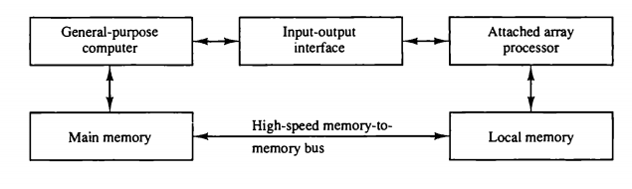
ATTACHED ARRAY PROCESSOR
Attached array processor has two interfaces:
Input output interface to a common processor.
Interface with a local memory.
Here local memory interconnects main memory. Host computer is general purpose computer. Attached processor is back end machine driven by the host computer.
The array processor is connected through an I/O controller to the computer & the computer treats it as an external interface.

Slide 27
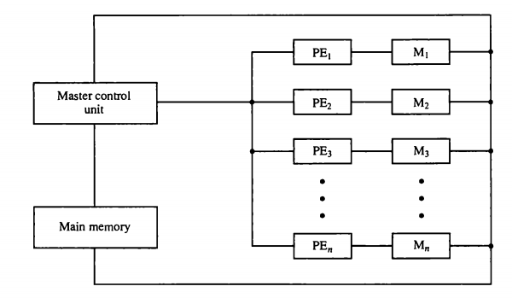
SIMD ARRAY PROCESSOR
This is a computer with multiple processing elements operating in parallel.
Both types of array processors, manipulate vectors but their internal organization is different.
SIMD is a computer with multiple PEs operating simultaneously.
The processing units are synchronized to perform the same operation under the control of a common control unit.
Thus providing a single instruction stream, multiple data stream (SIMD) organization.
As shown in figure, SIMD contains a set of identical processing elements (PES) each having a local memory M.
Each PE includes –
ALU
Floating point arithmetic unit
Working registers
Master control unit controls the operation in the PEs.
The function of master control unit is to decode the instruction and determine how the instruction to be executed.
If the instruction is scalar or program control instruction then it is directly executed within the master control unit.
Main memory is used for storage of the program while each PE uses operands stored in its local memory.

Slide 28
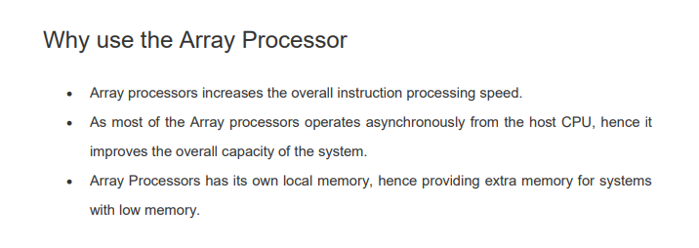

Slide 29
VECTOR PROCESSING
Vector Processing
Vector Processing Applications
Problems that can be efficiently formulated in terms of vectors
  Long-range weather forecasting
  Petroleum explorations
  Seismic data analysis
  Medical diagnosis
  Aerodynamics and space flight simulations
  Artificial intelligence and expert systems
  Mapping the human genome
  Image processing
Vector Processor (computer)
Ability to process vectors, and related data structures such as matrices
and multi-dimensional arrays, much faster than conventional computers
Vector Processors may also be pipelined

Slide 30
VECTOR PROGRAMMING
Vector Processing
DO 20 I = 1, 100
20 C(I) = B(I) + A(I)
Conventional computer
Initialize I = 0
20 Read A(I)
Read B(I)
Store C(I) = A(I) + B(I)
Increment I = i + 1
If I ≤ 100 goto 20
Vector computer
C(1:100) = A(1:100) + B(1:100)

Slide 31
VECTOR INSTRUCTIONS
Vector Processing
f1: V ∗ V
f2: V ∗ S
f3: V x V ∗ V
f4: V x S ∗ V
V: Vector operand
S: Scalar operand
Type Mnemonic Description (I = 1, ..., n)
  f1 VSQR Vector square root B(I) ∗ SQR(A(I))
  VSIN Vector sine B(I) ∗ sin(A(I))
  VCOM Vector complement A(I) ∗ A(I)
  f2 VSUM Vector summation S ∗ Σ A(I)
  VMAX Vector maximum S ∗ max{A(I)}
  f3 VADD Vector add C(I) ∗ A(I) + B(I)
  VMPY Vector multiply C(I) ∗ A(I) * B(I)
  VAND Vector AND C(I) ∗ A(I) . B(I)
  VLAR Vector larger C(I) ∗ max(A(I),B(I))
  VTGE Vector test > C(I) ∗ 0 if A(I) < B(I)
  C(I) ∗ 1 if A(I) > B(I)
  f4 SADD Vector-scalar add B(I) ∗ S + A(I)
  SDIV Vector-scalar divide B(I) ∗ A(I) / S

Slide 32
VECTOR INSTRUCTION FORMAT
Vector Processing
Vector Instruction Format
Pipeline for Inner Product

Slide 33
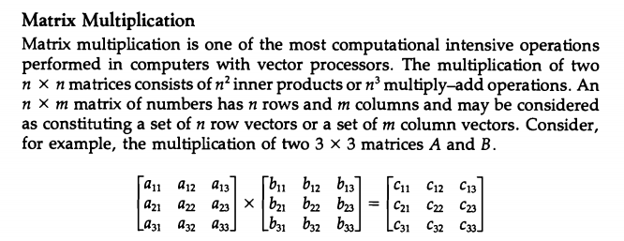
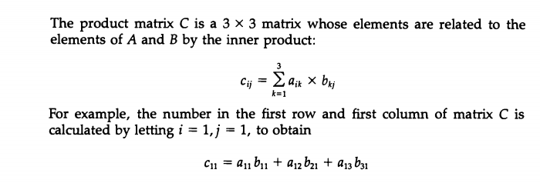

Slide 34
STRUCTURAL HAZARDS
Instruction Pipeline
Structural Hazards
Occur when some resource has not been
duplicated enough to allow all combinations
of instructions in the pipeline to execute
Example: With one memory-port, a data and an instruction fetch
cannot be initiated in the same clock
i
FI
DA
FO
EX
i+1
FI
DA
FO
EX
i+2
stall
stall
FI
DA
FO
EX
The Pipeline is stalled for a structural hazard
<- Two Loads with one port memory
-> Two-port memory will serve without stall

Slide 35
FORWARDING HARDWARE
Instruction Pipeline
Example:
ADD R1, R2, R3
SUB R4, R1, R5
3-stage Pipeline
I: Instruction Fetch
A: Decode, Read Registers,
ALU Operations
E: Write the result to the destination register
Register
file
MUX
MUX
Bypass
path
Result
write bus
ALU
R4
ALU result buffer
ADD
I
A
E
SUB
I
A
E
Without Bypassing
SUB
I
A
E
With Bypassing

Slide 36
CONTROL HAZARDS
Instruction Pipeline
Branch Instructions
- Branch target address is not known until
the branch instruction is completed
- Stall -> waste of cycle times
Branch
Instruction
FI DA FO EX
Next
Instruction
FI DA FO EX
Target address available
Dealing with Control Hazards
* Prefetch Target Instruction
* Branch Target Buffer
* Loop Buffer
* Branch Prediction
* Delayed Branch

Slide 37
CONTROL HAZARDS
Instruction Pipeline
Prefetch Target Instruction
  Fetch instructions in both streams, branch not taken and branch taken
  Both are saved until branch branch is executed. Then, select the right
  instruction stream and discard the wrong stream
Branch Target Buffer(BTB; Associative Memory)
  Entry: Addr of previously executed branches; Target instruction
  and the next few instructions
  When fetching an instruction, search BTB.
  If found, fetch the instruction stream in BTB;
  If not, new stream is fetched and update BTB
Loop Buffer(High Speed Register file)
  Storage of entire loop that allows to execute a loop without accessing memory
Branch Prediction
  Guessing the branch condition, and fetch an instruction stream based on
  the guess. Correct guess eliminates the branch penalty
Delayed Branch
  Compiler detects the branch and rearranges the instruction sequence
  by inserting useful instructions that keep the pipeline busy
  in the presence of a branch instruction

